Slide 1
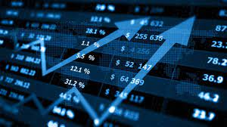
STOCK MARKET PRICE PREDICTION
Pranveer Singh Institute of Technology, Kanpur

Slide 2

Presented By: Kunal Gaurav Sisodiya (2101640140058) Malay Gupta (2101640140061) Aman Tiwari (2101641040010) Modh Waseem (2101640140066) Jitendra Shukla (2101640140043)
Presented To: Mr. Rahul Bajpai (PROFESSOR)
Pranveer Singh Institute of Technology, Kanpur

Slide 3
Content
Introduction
Aims & Objective
Modules
Project Scope
Tools and Technology
Data Flow Diagram
Future Scope
Conclusion

Slide 4
Introduction
Stock price prediction is the process of using historical data and statistical models to forecast the future prices of stocks. The stock market is a complex system, influenced by a variety of factors such as company earnings, economic indicators, news events, and geopolitical factors. Predicting stock prices accurately is challenging, but it can be useful for investors and traders who want to make informed decisions about buying and selling stocks.
Machine learning is an application of artificial intelligence (AI) that provides systems the ability to automatically learn and improve from experience without being explicitly programmed. Machine learning focuses on the development of computer programs that can access data and use it to learn for themselves.
The process of learning begins with observations or data, such as examples, direct experience, or instruction, in order to look for patterns in data and make better decisions in the future based on the examples that we provide. The primary aim is to allow the computers to learn automatically without human intervention or assistance and adjust actions accordingly.
Stock price prediction is a challenging and exciting field that has attracted the attention of researchers and practitioners in finance, machine learning, and artificial intelligence are helpful in this.

Slide 5
Aims and Objectives
To develop an accurate model for predicting stock prices.
To use machine learning and statistical analysis techniques to improve the accuracy of the model.
To help investors make informed decisions by providing them with reliable predictions of stock prices.
Collect historical stock market data for the company/stock of interest.
Clean and preprocess the data to remove any inconsistencies and outliers.
Develop a machine learning model (e.g. regression, neural network) to predict future stock prices based on the historical data.
Train and validate the model using a portion of the data, and test its accuracy using the remaining data.
Fine-tune the model to improve its accuracy and reduce any overfitting.
Evaluate the performance of the model using various metrics (e.g. Mean Absolute Error, Root Mean Squared Error).

Slide 6
Modules
Linear Regression: This is a simple and widely used technique for stock price prediction. It involves fitting a linear equation to the historical data and using it to predict future prices.
Random Forest Regression: This is a popular ensemble learning technique that uses multiple decision trees to make predictions. It is often used for stock price prediction due to its ability to handle non-linear relationships between variables.
Support Vector Regression: This is a powerful regression technique that is often used for stock price prediction. It works by mapping the data to a high-dimensional space and finding the hyperplane that best separates the data into different classes.
Convolutional Neural Networks (CNNs): This is a type of neural network that is often used for image analysis, but can also be used for time series analysis. It is often used for stock price prediction due to its ability to identify patterns in the data.

Slide 7
Project Scope
This project will focus exclusively on predicting the daily trend (price movement) of individual stocks. The project will make no attempt to deciding how much money to allocate to each prediction.
A system is essential to be built which will work with maximum accuracy and it should consider all important factors that could influence the result.
The goal of this project is to predict a stock price of a company according to it’s previous historical data. Stock Market Prediction is composed of main components: a company’s historical data of stock which will help to analyze the current and previous changes of stock price.
The above proposed model is easy to implement considering the available technology infrastructure. The model is simple, secure and scalable.
The proposed model is based on serial communication.
These model will help the investors to invest their money according to the predicted value.

Slide 8
Tools and Technology
TOOLS :
TensorFlow
Scikit
PyTorch
Prophet
Numpy

Slide 9
TECHNOLOGY:
Python
Big data platforms
Machine learning

Slide 10
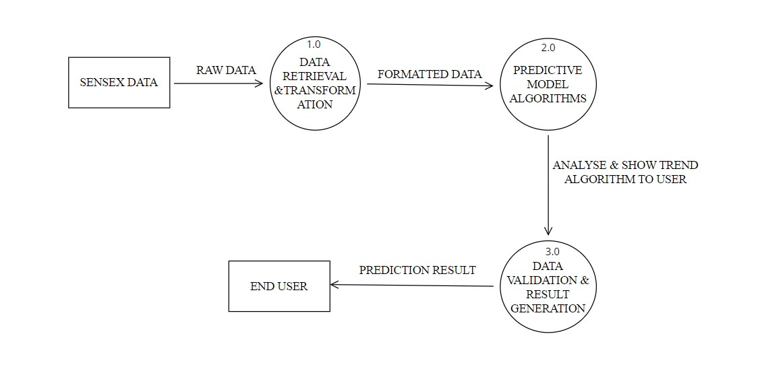
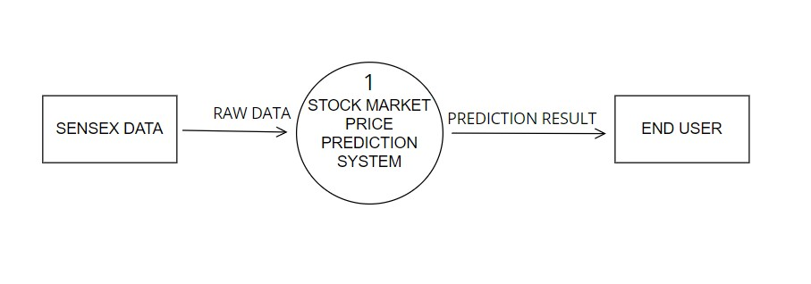
Data Flow Diagram
LEVEL 1
LEVEL 0

Slide 11
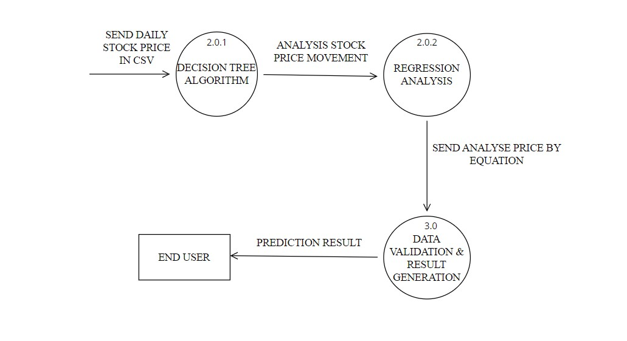
Data Flow Diagram
LEVEL 2

Slide 12
Future Scope
Future scope of this project will involve adding more parameters and factors like the financial ratios, multiple instances, etc. The more the parameters are taken into account more will be the accuracy. The algorithms can also be applied for analysing the contents of public comments and thus determine patterns/relationships between the customer and the corporate employee.
The use of traditional algorithms and data mining techniques can also help predict the corporation performance structure as a whole. In the future, we plan to integrate genetic algorithm or fuzzy logic. Genetic algorithm can be used to identify optimal network architecture and training parameters.
Fuzzy logic provides the ability to account for some uncertainty produced by the neural network predictions. Their uses in conjunction with neural network could provide an improvement for stock market prediction.

Slide 13
Conclusion
Stock is an unpredictable mechanism which follows the segments of chain and the dependencies of the same are unpredictable. It is defined to be an curve which keeps on changing and turning the price from low to high and vice-versa.
As the integration of the same is higher with other dependencies so leaving one dependencies compromises the level of accuracy.
Accuracy is not the term used over in stock as the actual prediction is not possible for any fiscal days it keeps on changing and turning the tables day and night.
Having higher component assets and the dependencies makes it more feasible and flexible in nature causing it even harder to predict.
The approx. value are taken into consideration and the hit or profit or the gain rate is calculated for the same.
In the project various machine learning algorithms are implemented and integrated and the output is generated from the same making a user visible with the outputs in the form of graph which makes it easier for them to see and interpret what’s the scenario and they can decide on the same to invest and get the benefit out of it,

Slide 14
Project Output

Slide 15
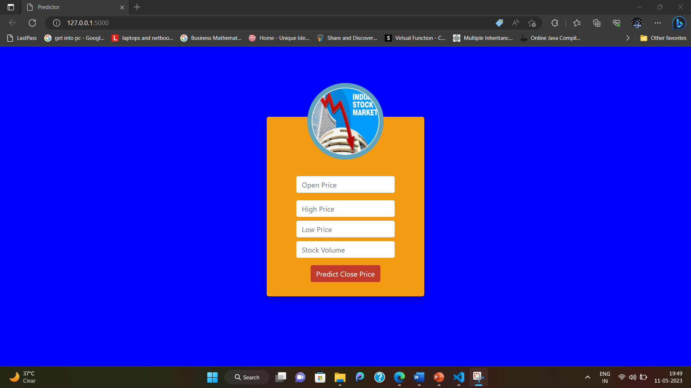

Slide 16
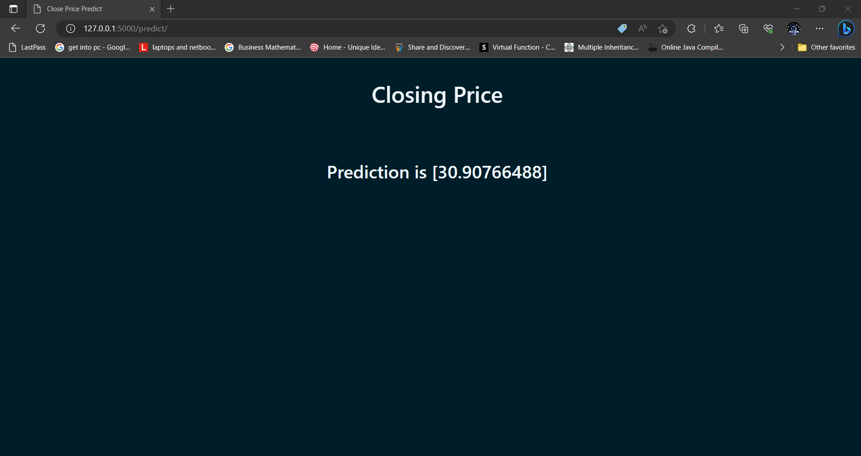

Slide 17
THANK YOU

